Slide 1
Discrete Mathematics and Logic (UE18CS205)
Unit 1 - Logic
Mr. Channa Bankapur (channabankapur@pes.edu)
Department of CS&E, PES University

Slide 2
An argument in propositional logic is a sequence of propositions. All but the final proposition in the argument are called premises and the final proposition is called conclusion. An argument is valid if the truth of all its premises implies that the conclusion is true.
The argument form with premises
p₁, p₂, …, p_{n} and conclusion q is valid,
when (p₁ ∧ p₂ ∧ … ∧ p_{n} ) → q
is a tautology.
p₁
p₂
…
p_{n}
----
∴ q

Slide 3
An Argument form with premises p₁, p₂, …, p_{n} and conclusion q is valid, when (p₁ ∧ p₂ ∧ … ∧ p_{n} ) → q is a tautology.
An argument form is represented as:
p₁
p₂
.
.
p_{n}
----
∴ q

Slide 4
Eg:
“If you are the topper the class, you will find a job”
“You are the topper the class”
--------------------------------
∴ “You will find a job”
It is a valid argument because it’s of the form
p → q
p
--------
∴ q
and ((p → q) ∧ p) → q is a tautology.

Slide 5
Rules of Inference:
We can use a truth table to show that an argument form is valid.
But when we have more propositional variables involved in the argument, solving by truth table is too laborious (having just 30 variables will require over a billion rows in the truth table).
That’s when we need well-known argument forms to simplify a complex argument form at hand.
These well-known valid argument forms are called Rules of Inference.

Slide 6
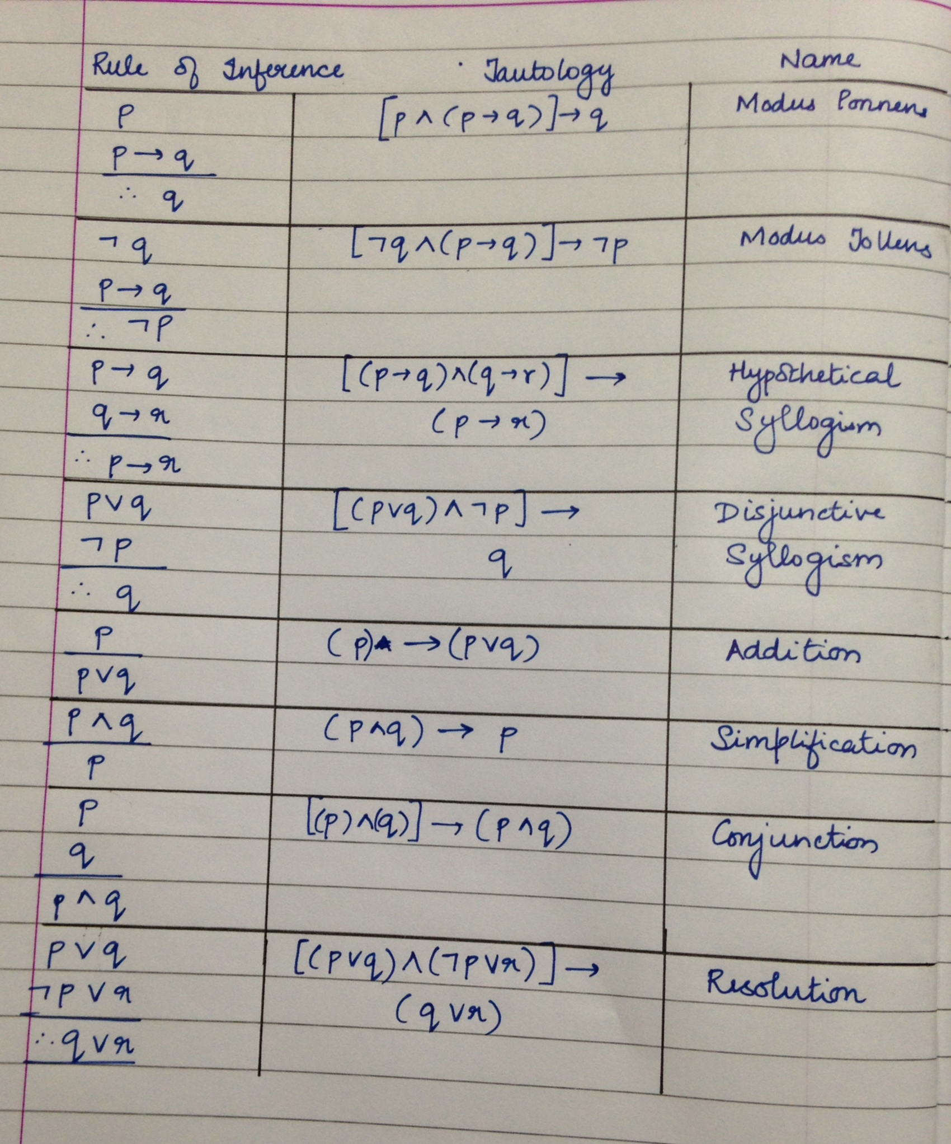

Slide 7
Modus Ponens
means, the way that affirms by affirming
aka Rule of Detachment
Example:
“If you are the topper the class, then you will find a job”
“You are the topper of the class”
Therefore, “You will find a job”
Example:
“If I lose the election, then will drink poison”
“I lost the election”
Therefore, “I will drink poison”
p → q
p
--------
∴ q

Slide 8
Modus Tollens
means, the way that denies by denying
aka Denying the Consequent
Example:
“If you are the topper the class, then you will find a job”
“You did not find a job”
Therefore, “You were not not topper of the class”
Example:
“When I earn a lot of money, I will buy a bungalow”
“I have not bought a bungalow yet”
Therefore, “I have not earnt a lot of money”
p → q
￢q
---------
∴ ￢p

Slide 9
Argument:
“If you are the topper the class, then you will find a job”
“You were not the topper of the class”
Therefore, “You will not a find a job”
Argument:
“If a Government is doing a good job, the economy of the country goes up”
“The economy of our country is going up”
Therefore, “Our Government is doing a good job”

Slide 10
What The Fallacy!
Argument:
“If you are the topper the class, then you will find a job”
“You were not the topper of the class”
Therefore, “You will not find a job”
Argument:
“If a Government is doing a good job, the economy of the country goes up”
“The economy of our country is going up”
Therefore, “Our Government is doing a good job”
p → q
￢p
---------
∴ ￢q
p → q
q
---------
∴ p

Slide 11
p → q p ----- ∴ q Modus Ponens | p → q q ----- ∴ p Fallacy of affirming the conclusion
Modus Tollens p → q ￢q ----- ∴ ￢p | Fallacy of denying the hypothesis p → q ￢p ----- ∴ ￢q

Slide 12
Hypothetical Syllogism
“If I do not wake up, I can not go to work”
“If I can not go to work, I will be poor”
Therefore, “If I do not wake up, I will be poor”
“If I study well, I understand the subject well”
“If I understand the subject well, I’ll get good grades”
Therefore, “If I study well, I’ll get good grades”
“When I earn a lot of money, I will buy a bungalow”
“If I buy a bungalow, I will be very happy”
Therefore, “When I earn a lot of money, I will be very happy”
p → q
q → r
-----------
∴ p → r

Slide 13
Disjunctive Syllogism
Example:
“Test is on tomorrow or day after”
“Test cannot happen tomorrow”
Therefore, “Test is on day after tomorrow”
Example:
“Either you or I have to pick our son from the school”
“I cannot pick up our son from the school”
Therefore, “You have to pick up our son from the school”
p ∨ q
￢p
---------
∴ q

Slide 14
Simplification
Example:
“You and I passed in the Examination”
Therefore, “I passed in the Examination”
p ∧ q
---------
∴ p

Slide 15
Conjunction
Example:
“You passed in the Examination”
“I passed in the Examination”
Therefore, “You and I passed in the Examination”
p
q
-----------
∴ p ∧ q

Slide 16
p
---------
∴ p ∨ q
Addition
“It is below freezing now”
Therefore, “It is below freezing or raining now”
“1+2=3”
Therefore, “1+2=3 or I am going win a lottery today”
“It rained today”
Imagine a predictive system made a statement yesterday
“It’s going to be cloudy or rainy tomorrow”
Therefore, the predictive system made true statement.

Slide 17
Resolution
p ⋁ q p ⋁ q
p → r ¬p ⋁ r
-------- --------
∴q ⋁ r ∴q ⋁ r
“Dharmendra loves Seeta or Geeta”
“If Dharmendra loves Seeta, then he’ll marry her”
∴ “Dharmendra loves Geeta or he marries Seeta”
“He has an offer from Google or Cisco”
“If he has an offer from Google, he will accept the offer”
∴ “He has an offer from Cisco or he has accepted Google’s offer”

Slide 18
Resolution rule
p ⋁ q₁ ⋁ q₂ ⋁ .. ⋁ q_{n}
¬p ⋁ r₁ ⋁ r₂ ⋁ .. ⋁ r_{m}
------------------------------------------------
∴q₁ ⋁ q₂ ⋁ .. ⋁ q_{n} ⋁ r₁ ⋁ r₂ ⋁ .. ⋁ r_{m}

Slide 19
Modus Ponens and Modus Tollens
(as a special case of the Resolution rule)
¬p ⋁ q
p ⋁ F
-----------
∴ q ⋁ F
¬p ⋁ q
¬q ⋁ F
-----------
∴ ¬p ⋁ F
p → q
p
--------
∴ q
p → q
￢q
---------
∴ ￢p

Slide 20
Hypothetical and Disjunctive Syllogisms
(as a special case of the Resolution rule)
¬p ⋁ q
¬q ⋁ r
-----------
∴ ¬p ⋁ r
p ⋁ q
¬p ⋁ F
-----------
∴ q ⋁ F
p → q
q → r
-----------
∴ p → r
p ∨ q
￢p
---------
∴ q

Slide 21
Q: What rule of inference is used in the following argument? Amar will do internship this summer. Therefore, this summer Amar will do internship or he will holiday in Goa.
Soln: Let
W : Amar will do internship this summer
B : Amar will holiday in Goa this summer
…

Slide 22
Q: What rule of inference is used in the following argument? Amar will do internship this summer. Therefore, this summer Amar will do internship or he will holiday in Goa.
Soln: Let
W : Amar will do internship this summer
B : Amar will holiday in Goa this summer
The argument is of the form
W
∴ W ⋁ B
The rule of inference used is: Addition.

Slide 23
W | B | W v B | W → W v B is tautology
T (will do internship) | T (will holiday at Goa) | T | T → T ≡ T
F (he will not do internship) | T | T | F → T ≡ T (it is true because the promise isn't being broken because the premise wasn't true in the first place)
T | F (will not holiday at Goa) | T | T → T ≡ T (promise is kept)
F | F | F | F → F ≡ T

Slide 24
Q: What rule of inference is used in the following argument? Jerry is a mathematics major and a Computer Science major. Therefore, Jerry is a mathematics major.
Soln: Let
…

Slide 25
Q: What rule of inference is used in the following argument? Jerry is a mathematics major and a Computer Science major. Therefore, Jerry is a mathematics major.
Soln: Let
M : Jerry is a mathematics major
C : Jerry is a Computer Science major
The argument is of the form
M ∧ C
∴ M
The rule of inference used is: Simplification.

Slide 26
Q: What rule of inference is used in the following argument?
If it is rainy, then the pool will be closed. It is rainy. Therefore, the pool is closed.
Soln: Let
…

Slide 27
Q: What rule of inference is used in the following argument? If it is rainy, then the pool will be closed. It is rainy. Therefore, the pool is closed.
Soln: Let
R : it is rainy
P : pool is closed
The argument is of the form
R → P
R
∴ P
The rule of inference used is: Modus Ponens.

Slide 28
Q: What rule of inference is used in the following argument? If there is a strike today, the university will close. The university is not closed today. Therefore, there was no strike today.
Soln: Let
…

Slide 29
Q: What rule of inference is used in the following argument? If there is a strike today, the university will close. The university is not closed today. Therefore, there was no strike today.
Soln: Let
S : there is a strike
C : university closes
The argument is of the form
S → C
¬C
∴ ¬S
The rule of inference used is: Modus Tollens.

Slide 30
Q: What rule of inference is used in the following argument?
If I go swimming, I will stay in the sun too long. If I stay in the sun too long, then I will sunburn. Therefore, if I go swimming, then I will sunburn.
Soln: Let
…

Slide 31
Q: What rule of inference is used in the following argument?
If I go swimming, I will stay in the sun too long. If I stay in the sun too long, then I will sunburn. Therefore, if I go swimming, then I will sunburn.
Soln: Let S1 : I go swim
S2 : I stay in the sun too long
S3 : I get sunburn
The argument is of the form
S1 → S2
S2 → S3
∴ S1 → S3
The rule of inference used is: Hypothetical Syllogism.

Slide 32
Q: What rule of inference is used in the following argument? Alice is a mathematics major. Therefore Alice is a mathematics major or a computer science major.
Soln: Let
M : Alice is a mathematics major
C : Alice is a Computer Science major.
…

Slide 33
Q: What rule of inference is used in the following argument? Alice is a mathematics major. Therefore Alice is a mathematics major or a computer science major.
Soln: Let
M : Alice is a mathematics major
C : Alice is a Computer Science major.
The argument is of the form
M
∴ M ⋁ C
The rule of inference used is: Addition.

Slide 34
Q: What rule of inference is used in the following argument? Kangaroos live in Australia and are marsupials. Therefore, kangaroos are marsupials.
Soln: Let
…

Slide 35
Q: What rule of inference is used in the following argument? Kangaroos live in Australia and are marsupials. Therefore, kangaroos are marsupials.
Soln: Let
A : Kangaroos live in Australia
M : Kangaroos are marsupials
The argument is of the form
A ∧ M
∴ M
The rule of inference used is: Simplification.

Slide 36
Q: What rule of inference is used in the following argument?
It is either hotter than 40 degrees today or the pollution is dangerous. It is lesser than 40 degrees outside today. Therefore, the pollution is dangerous.
Soln: Let
…

Slide 37
Q: What rule of inference is used in the following argument?
It is either hotter than 40 degrees today or the pollution is dangerous. It is lesser than 40 degrees outside today. Therefore, the pollution is dangerous.
Soln: Let
H : hotter than 40 degrees
P : pollution is dangerous
The argument is of the form
H ⋁ P
¬H
∴ P
The rule of inference used is: Disjunctive Syllogism.

Slide 38
Q: What rule of inference is used in the following argument? Linda is an excellent swimmer. If Linda is an excellent swimmer, she can work as a lifeguard. Therefore, Linda can work as a lifeguard.
Soln: Let
…

Slide 39
Q: What rule of inference is used in the following argument? Linda is an excellent swimmer. If Linda is an excellent swimmer, she can work as a lifeguard. Therefore, Linda can work as a lifeguard.
Soln: Let
S : Linda is an excellent swimmer
L : Linda can work as a lifeguard
The argument is of the form
S
S → L
∴ L
The rule of inference used is: Modus Ponens.

Slide 40
Q: What rule of inference is used in the following argument?
If I work all night on this homework, then I can answer all the exercises. If I can answer all the exercises, I will understand the material. Therefore, if I work all night on this assignment, I will understand the material.
Soln:
…

Slide 41
Q: What rule of inference is used in the following argument?
If I work all night on this homework, then I can answer all the exercises. If I can answer all the exercises, I will understand the material. Therefore, if I work all night on this assignment, I will understand the material.
Soln:
The argument is of the form
Work → Answer
Answer → Understand
∴ Work → Understand
The rule of inference used is: Hypothetical Syllogism.

Slide 42
Rules of Inference for Quantified Statements
Universal Instantiation
∀xP(x)
----------
∴ P(c) for any element ‘c’ in the domain
Example:
“All students of this class are smart”
Therefore, “Aditya, who is a student of this class, is smart”

Slide 43
Universal Generalization
P(c) for an arbitrary ‘c’
----------
∴ ∀xP(x)
Used to conclude ∀xP(x) is true given P(c) is true for an arbitrary element ‘c’ in the domain.
Example:
For an arbitrary integer c, c² ≥ 0. Because c is an arbitrary integer, we can generalize it for the domain of integers as ∀x (x² ≥ 0).

Slide 44
Logical Equivalences involving quantifiers
Q: Show that ∀x(P(x) ∧ Q(x)) ≡ ∀xP(x) ∧ ∀xQ(x) where the same domain is used throughout.
(That is, a universal quantifier can be distributed over a conjunction)
Proof: ∀x(P(x) ∧ Q(x)) ≡ ∀xP(x) ∧ ∀xQ(x) means
∀x(P(x) ∧ Q(x)) ↔ ∀xP(x) ∧ ∀xQ(x) is a tautology.
That is, to prove
∀x(P(x) ∧ Q(x)) → ∀xP(x) ∧ ∀xQ(x) is a tautology and
∀xP(x) ∧ ∀xQ(x) → ∀x(P(x) ∧ Q(x)) is a tautology.

Slide 45
To prove: ∀x(P(x) ∧ Q(x)) → ∀xP(x) ∧ ∀xQ(x) is a T.
Suppose, ∀x(P(x) ∧ Q(x)) is true.
P(a) ∧ Q(a) is true for any ‘a’ in the domain.
(By Universal Instantiation)
P(a) is true. Q(a) is true. (By Simplification)
Because ‘a’ is an arbitrary element in the domain and
P(a) is true, we can conclude that ∀xP(x) is true.
(By Universal Generalization)
Similarly, ∀xQ(x) is true.
That means ∀xP(x) ∧ ∀xQ(x) is true. (By Conjunction)
∴ ∀x(P(x)∧Q(x)) → ∀xP(x) ∧ ∀xQ(x) is a tautology ..①

Slide 46
To prove: ∀xP(x) ∧ ∀xQ(x) → ∀x(P(x) ∧ Q(x)) is a T.
Suppose, ∀xP(x) ∧ ∀xQ(x) is true.
i.e., ∀xP(x) is true and ∀xQ(x) is true.(By Simplification)
P(a) is true and Q(a) is true for any ‘a’ in the domain.
(By Universal Instantiation)
Because P(a) and Q(a) true for all values in the domain,
for a given ‘a’, P(a) ∧ Q(a). (By Conjunction)
Because ‘a’ is an arbitrary element in the domain,
∀x(P(x) ∧ Q(x)) is true (By Universal Generalization)
∴ ∀xP(x) ∧ ∀xQ(x) → ∀x(P(x)∧Q(x)) is a tautology. ---②
By ① and ②,
∀x(P(x) ∧ Q(x)) ↔ ∀xP(x) ∧ ∀xQ(x) is a tautology.
∴ ∀x(P(x) ∧ Q(x)) ≡ ∀xP(x) ∧ ∀xQ(x)

Slide 47
Existential Instantiation
∃xP(x)
----------
∴ P(c) for some element ‘c’
Used to conclude P(c) is true for some (not any) c given ∃xP(x) is true.
Existential Generalization
P(c) for some element ‘c’
----------
∴ ∃xP(x)
Used to conclude ∃xP(x) is true when P(c) is true for a particular element c.

Slide 48
Existential Generalization!
P(Salman Khan, Aishwarya Rai):
Salman Khan: Will you marry me?
Aishwarya Rai: No.
Salman Khan lived happily ever after!
∴∃ a boy and a girl P(boy, girl):
Boy: Will you marry me?
Girl: No.
Boy lived happily ever after!

Slide 49
Universal Modus Ponens:
Applying Universal Instantiation and then Modus Ponens is frequently used and hence given a name for it.
∀x(P(x) → Q(x))
P(a) where a is a particular element in the domain
----------
∴ Q(a)
Eg: ∀x (P(x) → Q(x)) Premise
P(a) → Q(a) Universal instantiation
P(a) Premise
Q(a) Modus ponens

Slide 50
Universal Modus Tollens:
Applying Universal Instantiation and then Modus Tollens is frequently used and hence given a name for it.
∀x(P(x) → Q(x))
￢Q(a) where a is a particular element in the domain
----------
∴ ￢P(a)
Eg: ∀x (P(x) → Q(x)) Premise
P(a) → Q(a) Universal instantiation
￢Q(a) Premise
￢P(a) Modus tollens

Slide 51
Q: Use rules of inference to check whether the argument is valid.
“Somebody in my friends circle enjoys whale watching”
“Every person who enjoys whale watching cares about ocean pollution”
Therefore, “There is a person in my friends circle who cares about ocean pollution”.
Soln: Let the domain be the set of all people.
C(x): x is in my friends circle
W(x): x enjoys whale watching
P(x): x cares about ocean pollution

Slide 52
1. ∃x (C(x) ∧ W(x)) Premise
2. C(a) ∧ W(a) Existential Instantiation
3. W(a) Simplification
4. ∀x (W(x) → P(x)) Premise
5. P(a) Universal Modus Ponens
6. C(a) Simplification of 2
7. C(a) ∧ P(a) Conjunction
8. ∃x (C(x) ∧ P(x)) Existential Generalization
That is, “There is a person who is in my friends circle and he/she cares about ocean pollution”.
Therefore, the argument is valid.

Slide 53
Eg: Show that the premises
“A student in this class has not read the book” and
“Everyone in this class passed the exam”
imply the conclusion “Someone who passed the exam has not read the book”.
Let the domain of x be all the people.
C(x): x is a student in this class
B(x): x has read the book
P(x): x passed the exam
Premise: ∃x (C(x) ⋀ ¬B(x))
Premise: ∀x (C(x) → P(x))
Conclusion: ∃x (P(x) ⋀ ¬B(x))

Slide 54
Premise: ∃x (C(x) ⋀ ¬B(x))
Premise: ∀x (C(x) → P(x))
Conclusion: ∃x (P(x) ⋀ ¬B(x))
1. ∃x (C(x) ⋀ ¬B(x)) Premise
2. C(a) ⋀ ¬B(a) Existential instantiation
3. C(a) Simplification
4. ∀x (C(x) → P(x)) Premise
5. C(a) → P(a) Universal instantiation
6. P(a) Modus ponens of 3,5
7. ¬B(a) Simplification of 2
8. P(a) ⋀ ¬B(a) Conjunction of 6,7
9. ∃x (P(x) ⋀ ¬B(x)) Existential generalization

Slide 55
Premise: ∃x (C(x) ⋀ ¬B(x))
Premise: ∀x (C(x) → P(x))
Conclusion: ∃x (P(x) ⋀ ¬B(x))
1. ∃x (C(x) ⋀ ¬B(x)) Premise
2. C(a) ⋀ ¬B(a) Existential instantiation
3. C(a) Simplification
4. ∀x (C(x) → P(x)) Premise
5. P(a) Universal Modus ponens of 3,4
6. ¬B(a) Simplification of 2
7. P(a) ⋀ ¬B(a) Conjunction of 6,7
8. ∃x (P(x) ⋀ ¬B(x)) Existential generalization

Slide 56
Q: Use rules of inference to check whether the argument is valid.
“Siri, a student in this batch, is an Algo guru”
“Everyone who is an Algo guru gets a high paying job”
∴ “Someone in this batch gets a high paying job”
Soln: Let the domain be the set of all people.
B(x): x is in this batch
A(x): x is an Algo guru
H(x): x gets a high paying job

Slide 57
1. B(Siri) ∧ A(Siri) Premise
2. A(Siri) Simplification
3. ∀x (A(x) → H(x)) Premise
4. H(Siri) Universal Modus Ponens
5. B(Siri) Simplification of 1
6. B(Siri) ∧ H(Siri) Conjunction of 4,5
7. ∃x (B(x) ∧ H(x)) Existential Generalization
That is, “Someone in this batch gets a high paying job”
Therefore, the argument is valid.

Slide 58
Q: Determine whether the argument is valid.
“If Superman were able and willing to prevent evil, then he would prevent evil”
“If Superman were unable to prevent evil, then he would be powerless”
“If Superman were unwilling to prevent evil, then he would be evil-minded”
“Superman does not prevent evil”
“If Superman exists, then he is neither powerless nor evil-minded”
Therefore, “Superman does not exists”.

Slide 59
Soln: Let
able: Superman is able to prevent evil
willing: Superman is willing to prevent evil
prev: Superman prevents evil
pless: Superman is powerless
evilm: Superman is evil-minded
exists: Superman exists

Slide 60
Soln: Let
able: Superman is able to prevent evil
willing: Superman is willing to prevent evil
prev: Superman prevents evil
pless: Superman is powerless
evilm: Superman is evil-minded
exists: Superman exists
1. (able ∧ willing) → prev Premise
2. ￢able → pless Premise
3. ￢willing → evilm Premise
4. ￢prev Premise
5. exists → ￢(pless ∨ evilm) Premise

Slide 61
1. (able ∧ willing) → prev Premise
2. ￢able → pless Premise
3. ￢willing → evilm Premise
4. ￢prev Premise
5. exists → ￢(pless ∨ evilm) Premise
6. ￢(able ∧ willing) Modus Tollens of 1,4
7. ￢able ∨ ￢willing De Morgan’s law
8. able ∨ pless Equivalent to 2
9. ￢willing ∨ pless Resolution of 7,8
10. willing ∨ evilm Equivalent to 3
11. pless ∨ evilm Resolution of 9,10
12. ￢exists Modus Tollens of 5,11
∴ the argument is valid.

Slide 62
Q. Determine the truth value of each of these statements if the domain for all variables consists of all integers.
∃x∀y (x < y²)
∀x∀y (x + y = 0)
∃x∃y (x² + y² = 6)
∀x∀y∃z (z = (x + y) / 2)

Slide 63
Q. Determine the truth value of each of these statements if the domain for all variables consists of all integers.
∃x∀y (x < y²)
TRUE
∀x∀y (x + y = 0)
FALSE
∃x∃y (x² + y² = 6)
FALSE
∀x∀y∃z (z = (x + y) / 2)
FALSE

Slide 64
Identify the rule of inference used in each of these arguments.
(i) You can enter the campus only if you wear your id card. You did not bring your id card. Therefore, you cannot enter the campus.
(ii) She is happy whenever it rains. She takes a selfie whenever she is happy. Therefore, she takes a selfie whenever it rains.
(iii) You have watched “3 Idiots” or you are an idiot. You like Rancho or you have not watched “3 Idiots”. Therefore, you are an idiot or you like Rancho.
Answers:
(i) …

Slide 65
Identify the rule of inference used in each of these arguments.
(i) You can enter the campus only if you wear your id card. You did not bring your id card. Therefore, you cannot enter the campus.
(ii) She is happy whenever it rains. She takes a selfie whenever she is happy. Therefore, she takes a selfie whenever it rains.
(iii) You have watched “3 Idiots” or you are an idiot. You like Rancho or you have not watched “3 Idiots”. Therefore, you are an idiot or you like Rancho.
Answers:
(i) Modus Tollens
(ii) Hypothetical Syllogism
(iii) Resolution

Slide 66
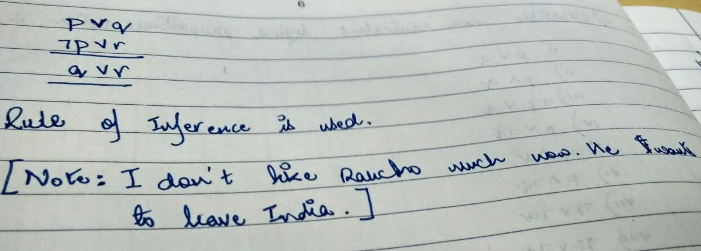
Identify the rule of inference used in each of these arguments.
(iii) You have watched “3 Idiots” or you are an idiot. You like Rancho or you have not watched “3 Idiots”. Therefore, you are an idiot or you like Rancho.
Answer: (iii) Resolution
Aamir Khan: “(Wife) Kiran and I have lived all our lives in India. For the first time, she said, should we move out of India? That’s a disastrous and big statement for Kiran to make to me. She fears for her child. She fears about what the atmosphere around us will be. She feels scared to open the news papers everyday. That does indicate that there is a sense of growing disquiet”

Slide 67
Q. What rules inference are used in this argument?
"No man is an island. Manhattan is an island. Therefore, Manhattan is not a man."
Q. Use rules of inference to find out for the hypotheses
"Randy works hard,"
"If Randy works hard, then he is a dull boy," and
"If Randy is a dull boy, then he will not get the job",
which one of the following two statements can be implied
1. "Randy will get the job"
2. "Randy will not get the job"

Slide 68
Q. What rules of inference are used in this famous argument?
"All men are mortal. Socrates is a man. Therefore, Socrates is mortal."
Q. Use rules of inference to show that the hypotheses "If it does not rain or if it is not foggy, then the sailing race will be held and the lifesaving demonstration will go on," "If the sailing race is held, then the trophy will be awarded," and "The trophy was not awarded" imply the conclusion "It rained".

Slide 69
Q. In the domain of a selected group of men, we know that
“Every man is married or happy”,
“Every man is rich or not happy”,
“If a man is lazy then he is not rich” and
“There is a man, who is not married”.
Use rules of inference (including quantifiers) to show that the above hypotheses imply the conclusion “There is a man, who is not lazy”.

Slide 70
Q. Use rules of inference to show that the premises
“If he gets a bonus, then he will buy a car”,
“If he gets a salary-hike, then he will buy a house”,
“His wife will be sad only if he neither buys a car nor buys a house” and
“He will get a bonus or a salary-hike”
imply the conclusion
“His wife will not be sad”.

Slide 71
Q: There are three people A, B and C. A is looking at B and B is looking at C. A is married and C is not. Does it follow that a married person is looking at an unmarried one? Justify.
Unrelated fact: Anterior Cingulate Cortex is a part of the brain, which monitors step-by-step process of problem solving. So, it’s the control center of logic. It coordinates all the information stored in your memory to think of creative solutions to the puzzles.

Slide 72
Puzzle: Each student of our department always tells the truth or always lies. A student gives only a “Yes” or a “No” response to a question a visitor asks. Suppose a visitor arrives for visiting the chairperson of the department and has come to a fork where one way leads to the chairperson’s room and the other way does not. One of our students is standing at the fork. What one question can the visitor ask the student to determine which way leads to the chairperson’s room?

Slide 73
< End of Logic. Long live logic! />
¬false

